Slide 1
Data Processing
Feature
Engineering
Clustering
Prediction
Feature extraction (PCA)
‘Pickup/ dropoff_pca’:
8*pickup/ dropoff + lat/long
Outlier
Cluster by
MiniBatchKMeans
TPOT
+
Cross Validation
XGBRegressor
Feature Creation (Distance)
Missing data
Haversine distance,
Manhattan distance,
Bearing direction
Filter and get:
trips beyond 60 mins
Predict
Missing data
+
Feature Creation (Date/Time)
+ cyclic processing
OSRM
(Open Source Routing Machine)
Date/timedata
Day of year,
Hour of week
Week of year…
Feature Creation (Speed)
avg_speed_h
XGBoosting
Feature Creation (…)
Predict

Slide 2
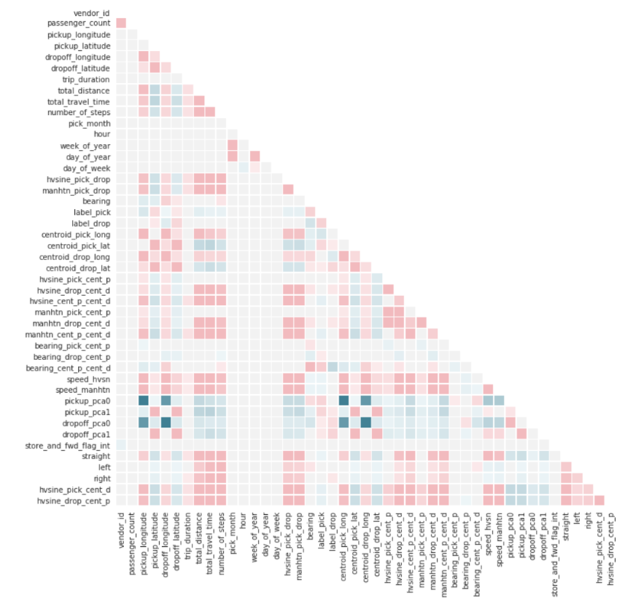
Data Processing
Feature
Engineering
Correlation
Analytics
Feature extraction (PCA)
‘Pickup/ dropoff_pca’:
8*pickup/ dropoff + lat/long
Outlier
Feature Creation (Distance)
Missing data
Weather
Dataset
Haversine distance,
Manhattan distance,
Bearing direction
+
Missing data
Feature Creation (Date/Time)
+ cyclic processing
Date/timedata
Day of year,
Hour of week
Week of year…
Feature Creation (Speed)
avg_speed_h
Feature Creation (…)

Slide 3
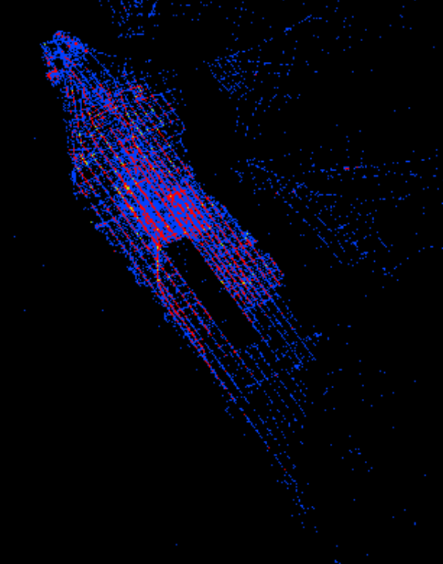
Data Processing
Dynamic
Animation
Original
Data
OSRM
(Open Source Routing Machine)
+
Filter the density
plot
Limit the
Lat/long
Stack
Animate
Process
Lat/long

Slide 4
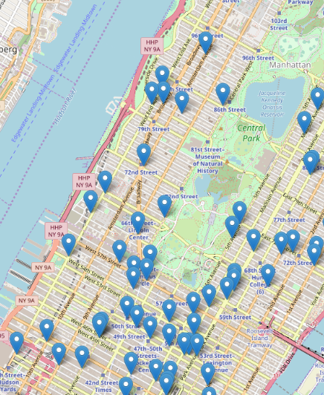
Data Processing
Plot Folium
Map
Cluster by centroid lat/long
Count id,
filtered by trip time
Calculate average
trip time

Slide 5

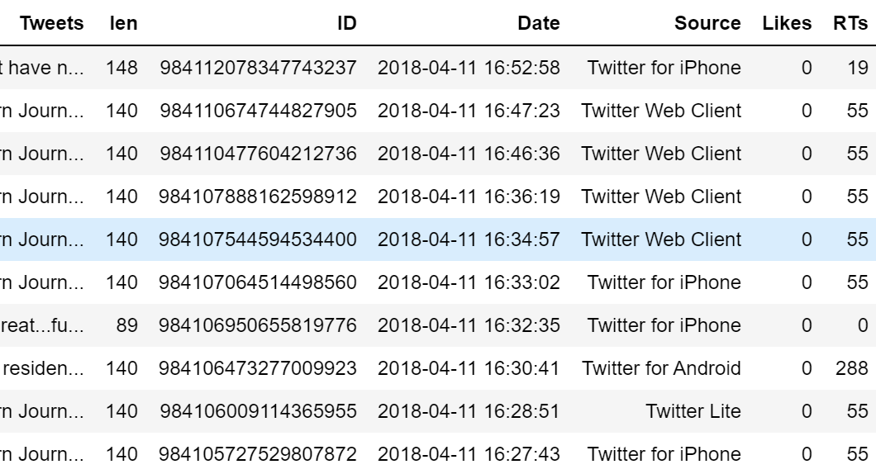
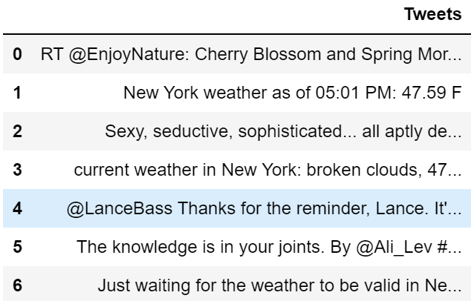
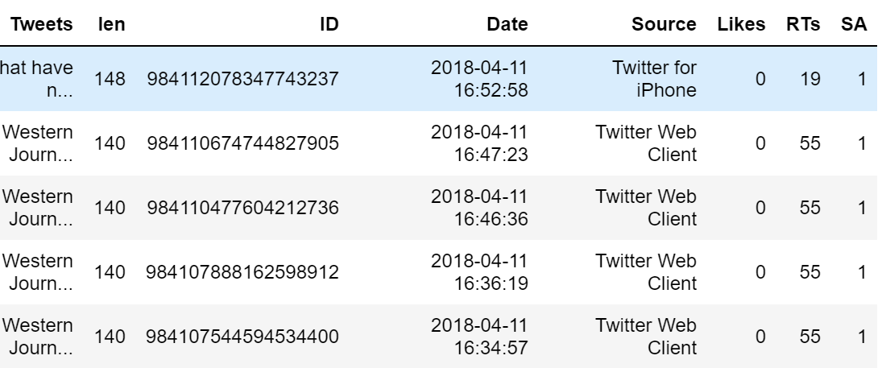
Polarity label
Classify by semantics results
Percentage of Cambridge traffic positive tweets: 86.667%
Percentage of Cambridge traffic neutral tweets: 13.334%
Percentage de Cambridge traffic negative tweets: 0.0%
Calculate portion
Positive/Negative/Neutral
Positive/Negative/Neutral
Compare
Percentage of Cambridge weather positive tweets: 60.0%
Percentage of Cambridge weather neutral tweets: 13.334%
Percentage de Cambridge weather negative tweets: 26.668%

